Slide 1

DATABASE COURSE 2023/2024
SESSION 8

Slide 2
SESSION 8
CARTESIAN PRODUCT
SQL JOINS
SETS OPERATIONS

Slide 3
CARTESIAN PRODUCT
BBDD/User: mydata
MySQL
CREATE TABLE T1 (T1_C1 INTEGER, T1_C2 INTEGER);
INSERT INTO T1 VALUES (1,2);
INSERT INTO T1 VALUES (3,4);
CREATE TABLE T2 (T2_C1 INTEGER, T2_C2 INTEGER);
INSERT INTO T2 VALUES (5,6);
INSERT INTO T2 VALUES (7,8);
Oracle
CREATE TABLE T1 (T1_C1 NUMBER, T1_C2 NUMBER);
INSERT INTO T1 VALUES (1,2);
INSERT INTO T1 VALUES (3,4);
CREATE TABLE T2 (T2_C1 NUMBER, T2_C2 NUMBER);
INSERT INTO T2 VALUES (5,6);
INSERT INTO T2 VALUES (7,8);

Slide 4


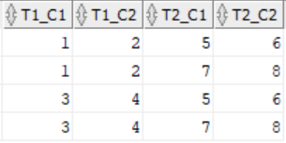
CARTESIAN PRODUCT
BBDD/User: mydata
MySQL/Oracle
MySQL/Oracle
SELECT * FROM T1
SELECT * FROM T2
MySQL/Oracle
SELECT * FROM T1 , T2

Slide 5
SESSION 8
CARTESIAN PRODUCT
SQL JOINS
SETS OPERATIONS

Slide 6
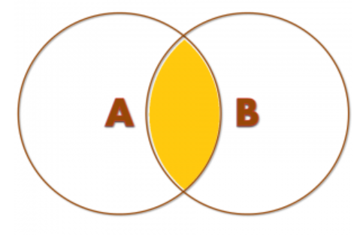
SQL JOINS
INNER JOIN Concept
INNER JOIN. Records included in both tables only.
Notes:
Necesario importar datos de:
/people
/simpsons
/world
/dallas
/project

Slide 7
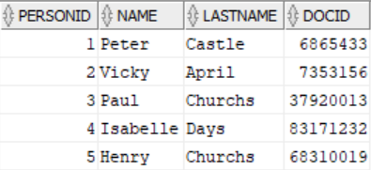
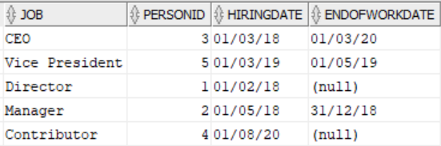
SQL JOINS
INNER JOIN Example
BBDD/User: people
People Table
PeopleJob
Table
MySQL/Oracle
SELECT t1.job, t2.name, t2.lastname, t1.hiringdate, t1.endofworkdate
FROM peoplejob t1 INNER JOIN people t2 ON (t1.personid = t2.personid);

Slide 8
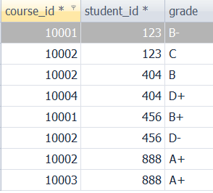
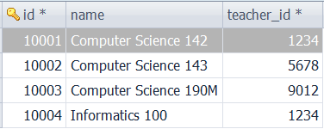
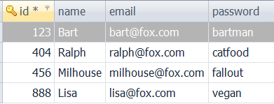
SQL JOINS
INNER JOIN Example
BBDD/User: simpsons
Course Table
Student Table
Grade Table
MySQL/Oracle
SELECT t3.name, t1.name, t2.grade
FROM course t1 INNER JOIN grade t2 ON (t1.id = t2.course_id)
INNER JOIN student t3 ON (t2.student_id = t3.id);

Slide 9
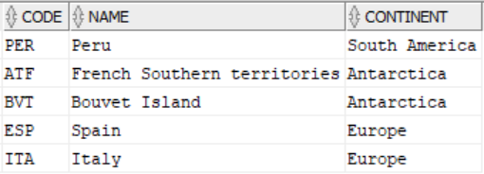
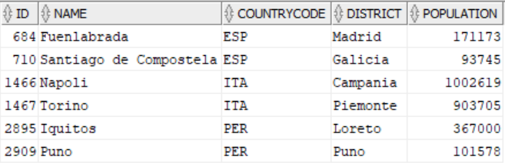
SQL JOINS
INNER JOIN Example
BBDD/User: world
Country Table
City Table
MySQL/Oracle
SELECT t2.code, t2.name, t2.continent,t1.name AS cityname, t1.countrycode, t1.population
FROM country t2 INNER JOIN city t1
ON (t1.countrycode = t2.code);
¿Should Countries: “French Southern territories” and “Bouvet Island” appear in above query?

Slide 10
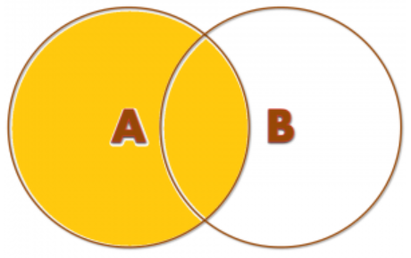
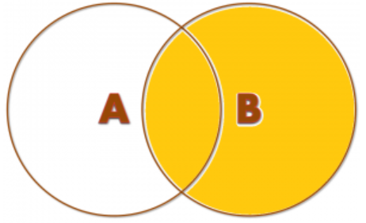
SQL JOINS
LEFT/RIGHT JOIN Concept
LEFT JOIN. All records from the table at the “left”
RIGHT JOIN. All records from the table at the “right”

Slide 11
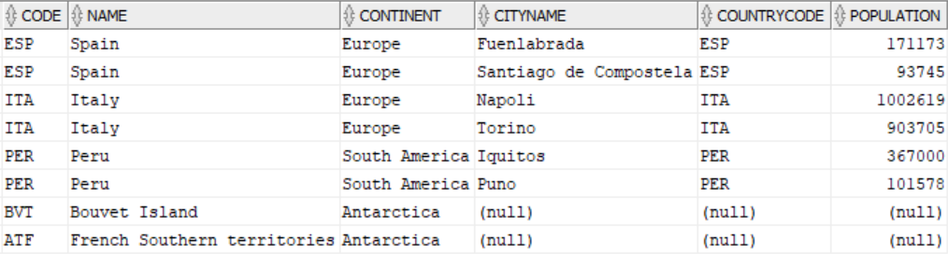
SQL JOINS
LEFT/RIGHT JOIN Example
BBDD/User: world
MySQL/Oracle
SELECT t2.code, t2.name, t2.continent,t1.name AS cityname, t1.countrycode, t1.population
FROM country t2 LEFT JOIN city t1
ON (t1.countrycode = t2.code);
MySQL/Oracle
SELECT t2.code, t2.name, t2.continent,t1.name AS cityname, t1.countrycode, t1.population
FROM city t1 RIGHT JOIN country t2
ON (t1.countrycode = t2.code);

Slide 12
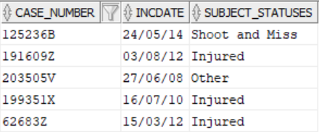


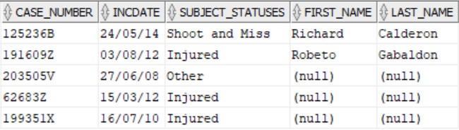
SQL JOINS
RIGHT JOIN Example
BBDD/User: dallas
Incident Table
Subject Table
MySQL/Oracle
SELECT t1.case_number, t1.incdate, t1.subject_statuses, t2.first_name, t2.last_name
FROM subject t2 INNER JOIN incident t1 ON t1.case_number = t2.case_number;
MySQL/Oracle
SELECT t1.case_number, t1.incdate, t1.subject_statuses, t2.first_name, t2.last_name
FROM subject t2 RIGHT JOIN incident t1 ON t1.case_number = t2.case_number;

Slide 13
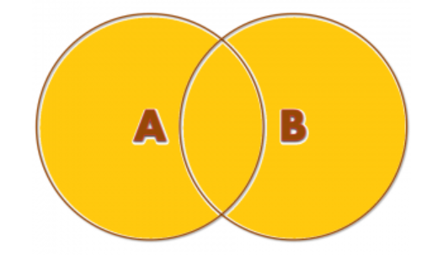
SQL JOINS
FULL OUTER JOIN Concept
FULL OUTER JOIN. All records in both tables

Slide 14

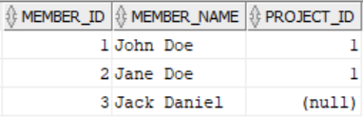
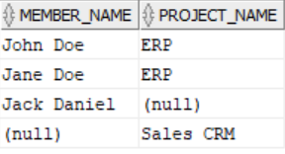
SQL JOINS
FULL OUTER JOIN Example
BBDD/User: project
Project Table
Member Table
Oracle
SELECT member_name, project_name
FROM member m FULL OUTER JOIN project p ON p.project_id = m.project_id;

Slide 15
SQL JOINS
JOINs Summary
INNER JOIN
LEFT JOIN
RIGHT JOIN
FULL OUTER JOIN

Slide 16
SESSION 8
CARTESIAN PRODUCT
SQL JOINS
SETS OPERATIONS

Slide 17
SETS OPERATIONS
UNION, UNION ALL, MINUS INTERSECT Example
BBDD/User: mydata
MySQL
CREATE TABLE TX1 ( TX1C1 INTEGER, TX1C2 INTEGER, TX1C3 VARCHAR(50));
CREATE TABLE TX2 ( TX2C1 INTEGER, TX2C2 INTEGER, TX2C3 VARCHAR(50));
Oracle
CREATE TABLE TX1 ( TX1C1 NUMBER, TX1C2 NUMBER, TX1C3 VARCHAR2(50));
CREATE TABLE TX2 ( TX2C1 NUMBER, TX2C2 NUMBER, TX2C3 VARCHAR2(50));
MySQL/Oracle
MySQL/Oracle
INSERT INTO TX1 VALUES (1,1,'11');
INSERT INTO TX1 VALUES (1,2,'12');
INSERT INTO TX2 VALUES (1,2,'12');
INSERT INTO TX2 VALUES (1,3,'13');

Slide 18


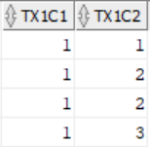
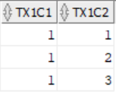
SETS OPERATIONS
UNION, UNION ALL, MINUS INTERSECT Example
BBDD/User: mydata
TX1
TX2
MySQL/Oracle
SELECT TX1C1, TX1C2 FROM TX1
UNION ALL
SELECT TX2C1, TX2C2 FROM TX2;
MySQL/Oracle
SELECT TX1C1, TX1C2 FROM TX1
UNION
SELECT TX2C1, TX2C2 FROM TX2;

Slide 19


SETS OPERATIONS
UNION, UNION ALL, MINUS INTERSECT Example
BBDD/User: mydata
TX1
TX2
Oracle
SELECT TX1C1, TX1C2 FROM TX1
MINUS
SELECT TX2C1, TX2C2 FROM TX2;
Oracle
SELECT TX1C1, TX1C2 FROM TX1
INTERSECT
SELECT TX2C1, TX2C2 FROM TX2;

